Slide 1
OUTLINE
HASHING
TYPES OF HASHING
1)STATIC HASHING
2)DYNAMIC HASHING

Slide 2
HASHING
Hashing is an effective technique to calculate the direct location of a data record on the disk without using index structure.
Hashing uses hash function with search key as parameters to generate the address of a data record.

Slide 3
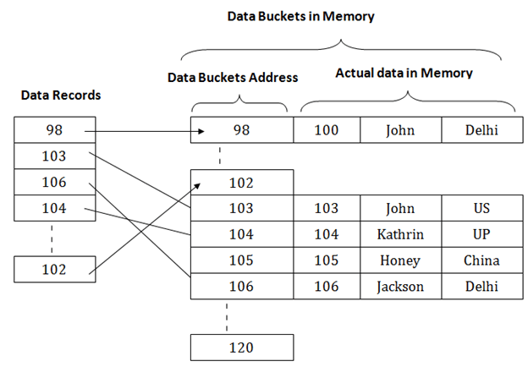
HASHING EXAMPLE

Slide 4
HASH FUNCTION
Hash function maps a big number or string to a small integer that can be used as index in hash table.
HASH FUNCTION h(x):
h(x)=x mod(m)
Example:
let x=9875639(key)mod=5( Number of Data blocks )
h(x)=9875639 mod(5) = 4

Slide 5
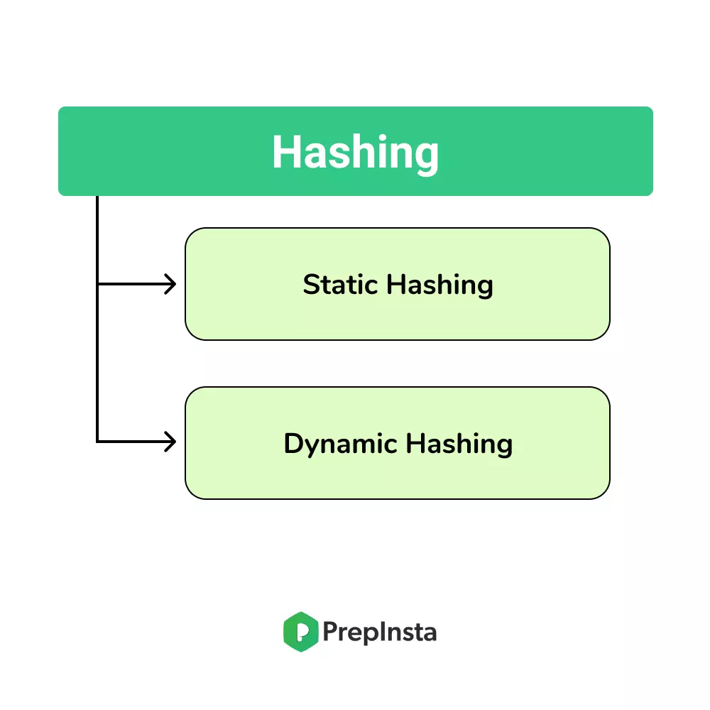
TYPES OF HASHING

Slide 6
STATIC HASHING
In Static Hashing , the resultant data bucket address will always be the same.
The number of data buckets in memory remains constant throughout.
EXAMPLE:
If we generate an address for EMP_ID=103 using hash function mod(5) then it will always result in same bucket address 3.
Here , there will be no change in the bucket address

Slide 7
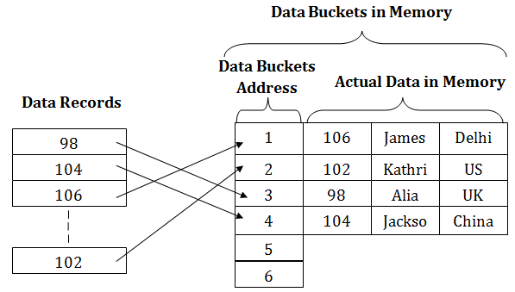
EXAMPLE

Slide 8
OPERATIONS IN STATIC HASHING
Search
Delete
Insert
Update

Slide 9
BUCKET OVERFLOW
If we want to insert some new record into the file but , the address generated by the hash function is not empty or data already exists in that address, this critical situation is called “BUCKET OVERFLOW”.

Slide 10
To overcome this Bucket overflow , commonly used methods are,
OPEN HASHING (or) LINEAR PROBING
CLOSE HASHING (or) OVERFLOW CHAINING

Slide 11
OPEN HASHING
When a hash function generates an address at which data is already stored , then the next bucket will be allocated to it.
This mechanism is called as “LINEAR PROBING”.

Slide 12
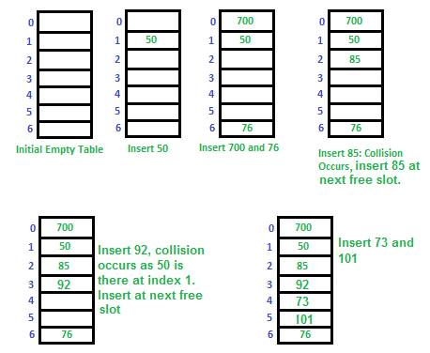
EXAMPLE FOR OPEN HASHING

Slide 13
CLOSE HASHING
In closed hashing method , a new data bucket is allocated with same address and is linked it after the previous one.
This mechanism is known as “Overflow chaining”.

Slide 14
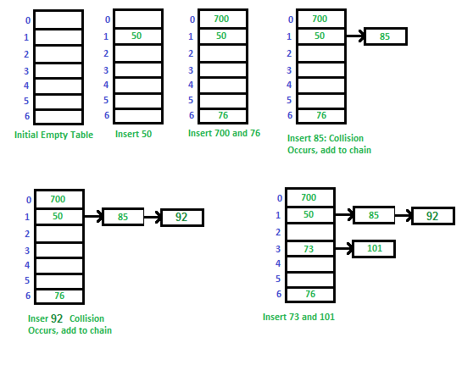
EXAMPLE FOR CLOSE HASHING

Slide 15
DYNAMIC HASHING
The dynamic hashing method is used to overcome the problems of static hashing like bucket overflow.
In this method , data buckets grow or shrink as the record increases or decreases.
This method is also known as “EXTENDABLE HASHING METHOD”.

Slide 16
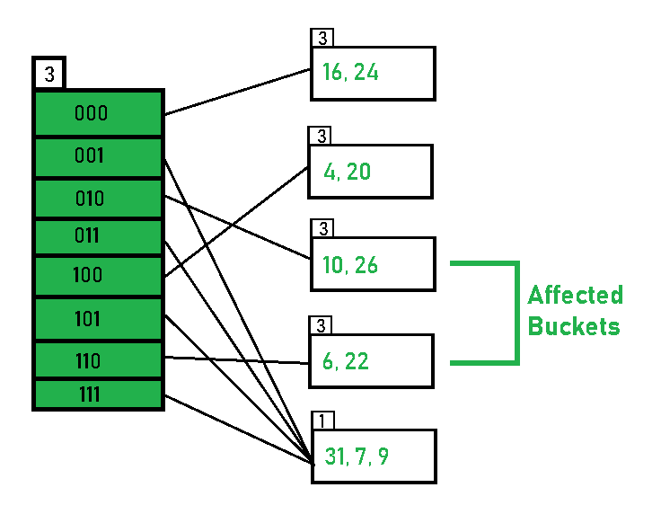
EXAMPLE FOR DYNAMIC HASHING

Slide 17
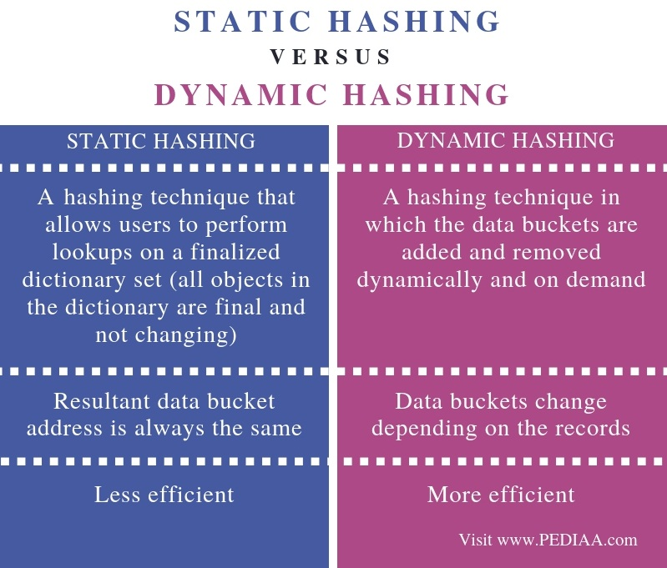
STATIC VS DYNAMIC HASHING

Slide 18


